Slide 1
Managing Users and Groups
Assume Superuser Privileges
Create, Modify, and Delete Users
Create, Modify, and Delete Groups
Query Users and Groups
Configure Account Profiles

Slide 2

Topic A: Assume Superuser Privileges
Exam Objectives:
3.1 Given a scenario, apply or acquire the appropriate user and/or group permissions and ownership.

Slide 3
User Accounts
An object that represents a person's identity to the operating system and is used to perform certain tasks.
User info includes group memberships.
Individuals should have their own unique accounts.
Admins use accounts to control access.
System references accounts by UID.
Accounts have several attributes.

Slide 4
Types of User Accounts
Root user
Plays role of local admin.
Provides security context for apps and commands.
More powerful than local admin in Windows.
Standard user
Represents regular human user.
Most tasks only require standard user privileges.
Can also be configured to assume root privileges when needed.
Service user
Represents apps that consume system resources.
Disabled for regular log on.
Usually owns configuration files and/or executables.

Slide 5
Superuser
The local administrative account on a Linux system, typically named root.
Used to manage users, configure devices, etc.
System runs services as root.
May run potentially destructive commands.
Best practice is to not log on as root.
Elevate privileges from non-privileged account when necessary.

Slide 6
Principle of Least Privilege
A best practice that states that users should have as much access as is required to do their job, but no more than that.
Example: User needs to read but not write to a file.
Only give user read access.
Example: User needs to restart but not reconfigure.
Only give user restart privileges.
Easier to give more access than take away existing access.
Enhances security of the system.

Slide 7
The su Command (Slide 1 of 2)
Used to substitute user/elevate privileges.
Without option, switches identity to given user.
Retains original user's profile/variables.
Switched user remains in home directory of original user.
Prompts for password of switched user.
With a hyphen, launches new shell for switched user.
Better practice.
Also prompts for password.
Notes:
Teaching Tip: Consider mentioning that the root user in Linux is more powerful than the administrator account in Windows.

Slide 8
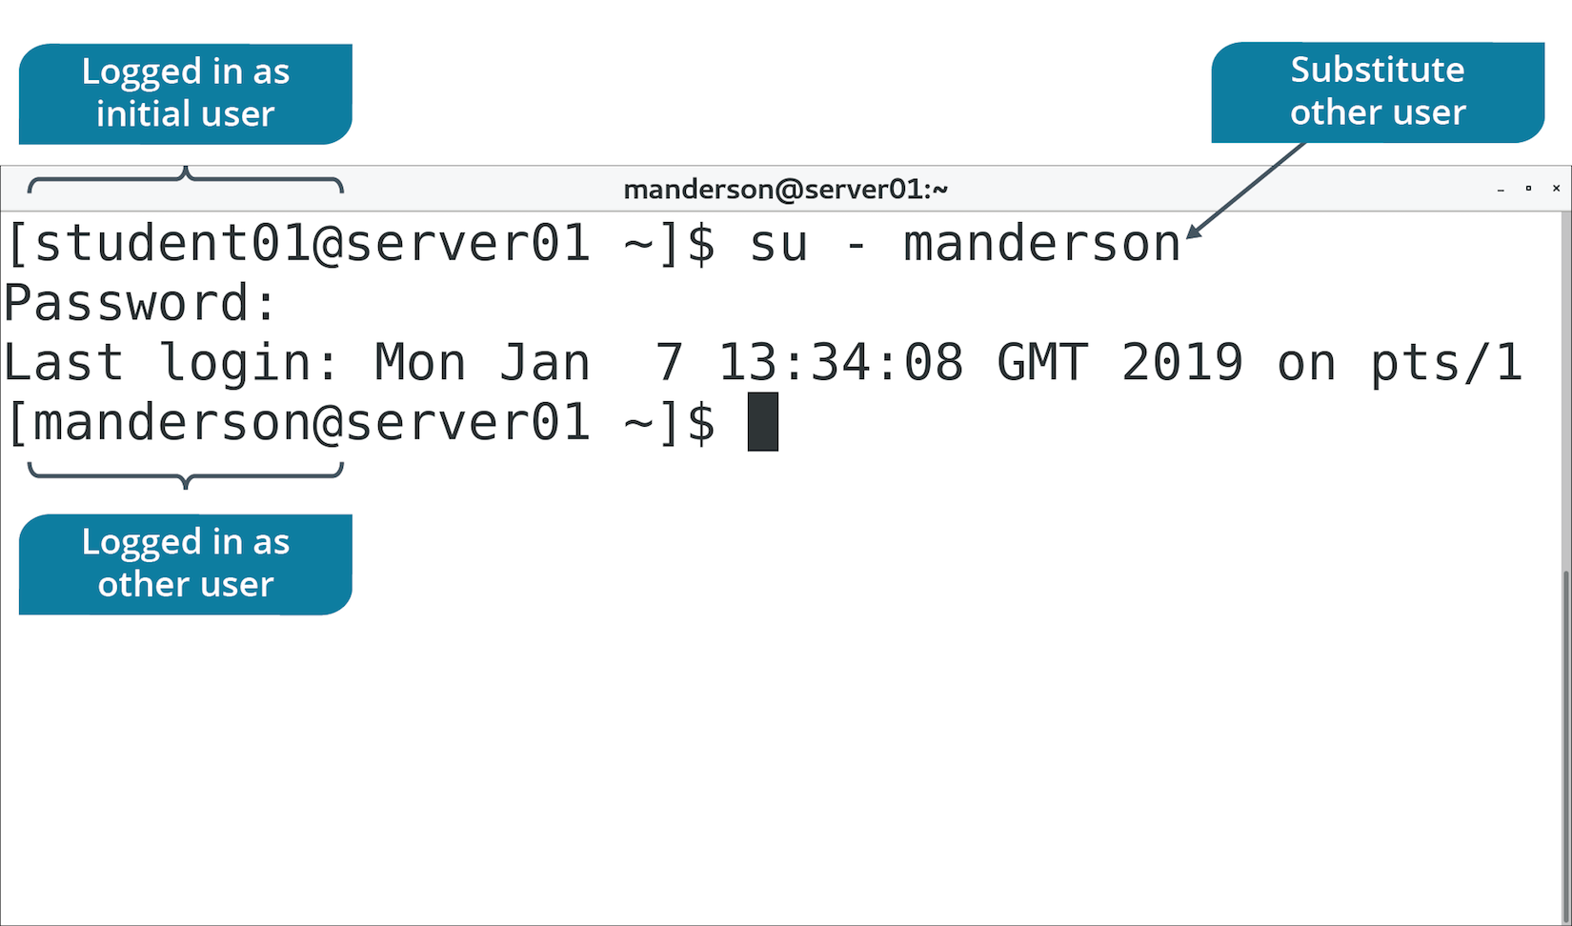
The su Command (Slide 2 of 2)

Slide 9
The sudo Command
Using su - root is usually more power than necessary.
sudo is used to execute specific commands as root.
Delegate access in /etc/sudoers file.
Use visudo editor.
You can give users permission to run specific commands.
Avoids giving users full admin privileges.

Slide 10
The sudoedit Command
Simpler and more secure option of editing files with other privileges.
User can use preferred text editor to open file.
Example entry in sudoers:
%editors ALL = sudoedit /path/to/file
Members of editors can enter sudoedit /path/to/file
sudo is better for running commands, sudoedit for files.

Slide 11
The visudo Command (Slide 1 of 2)
Don't edit /etc/sudoers with a normal text editor.
Mistakes can render server inoperable.
visudo command verifies syntax before committing changes.
Can correct mistakes before they become official.

Slide 12
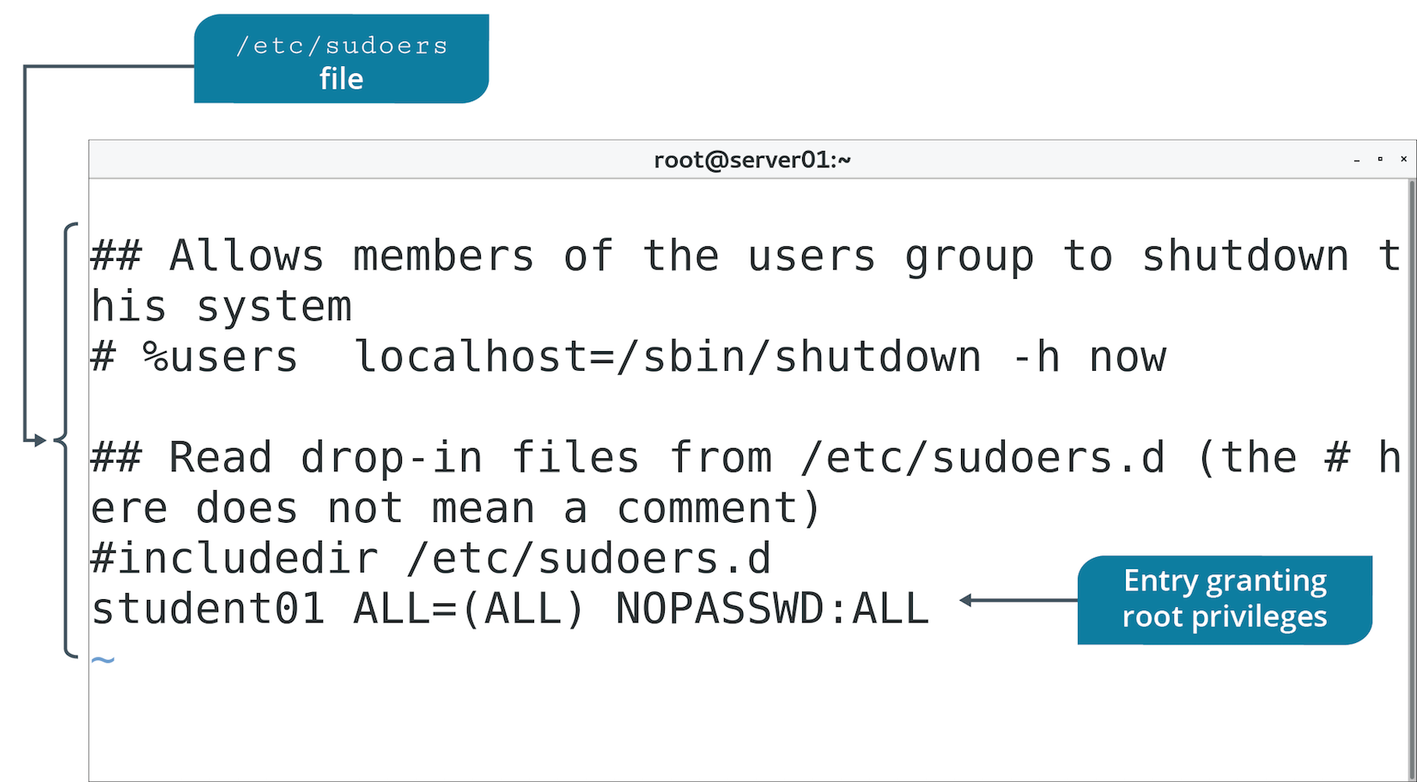
The visudo Command (Slide 2 of 2)

Slide 13
The wheel Group
Some distros disable root altogether.
Enable admin privileges by membership to wheel group.
Less potential for damaging system.
Use visudo to edit wheel group's privileges.
Add users to wheel group to give them privileges.
Be cautious about wheel group membership.

Slide 14
Discussing Superuser Privileges

Slide 15
Activity 2-1: Discussing Superuser Privileges
Name the three types of Linux user accounts.
ANSWER:
Root user (superuser), standard user, and service.

Slide 16
Activity 2-1: Discussing Superuser Privileges
You need to add an administrator to the /etc/sudoers file to give them the ability to use the sudo command. Which command must you use to add users to the /etc/sudoers file?
ANSWER:
You must use visudo since you cannot edit the /etc/sudoers file directly with Vim or other text editors.

Slide 17
Activity 2-1: Discussing Superuser Privileges
Why is it a security best practice to log onto a Linux system with a regular user account rather than with the root user account?
ANSWER:
The primary reason is to prevent harmful mistakes from happening to the system through errant commands such as rm (remove). Users who can use the sudo command should do so on an individual command basis to perform necessary tasks with elevated privileges, while remaining in their user shells for other functions.

Slide 18
Activity 2-1: Discussing Superuser Privileges
Why is it important to put the principle of least privilege into practice?
ANSWER:
System security is greatly enhanced by only granting users the minimum amount of rights and permissions they require to perform a task.

Slide 19
Activity 2-1: Discussing Superuser Privileges
Describe the difference between using the su command and using the sudo command to perform administrative tasks.
ANSWER:
The su command enables an authorized user to become the root user by switching to the root user account in a complete root-owned shell. This is handy for the administrator but very dangerous because of the potential for human error. The sudo command enables an authorized user to issue individual commands as the root (or other user), limiting potential damage to the system.

Slide 20
Activity: Assuming Superuser Privileges
You've been told about the dangers of using root account.
Users should have no more access than needed.
Develetech policy states admin access should be carefully controlled.
You need to identify how to satisfy this requirement.

Slide 21
Topic B: Create, Modify, and Delete Users
Exam Objectives
2.2 Given a scenario, manage users and groups.
3.1 Given a scenario, apply or acquire the appropriate user and/or group permissions and ownership.

Slide 22
The useradd Command
Creates user accounts and configures user settings.
Creates account in /etc/passwd file.
References /etc/login.defs for configs.
Creates user's home directory in /home/<account name>
Populates home directory from files in /etc/skel
No password set by default.
Will exist, but not usable.

Slide 23
useradd Command Options
Option | Description | Example
-c | Sets comment field. | useradd -c "User One" user1
-e | Sets account expiration date. | useradd -e 2019/12/31
-s | Sets user's default shell. | useradd -s /bin/ksh
-D | View default config for new users. | useradd -D

Slide 24
The passwd Command (Slide 1 of 2)
Used by root to set/reset user's password.
User can reset own password with command.
Also used after useradd to set initial password.

Slide 25
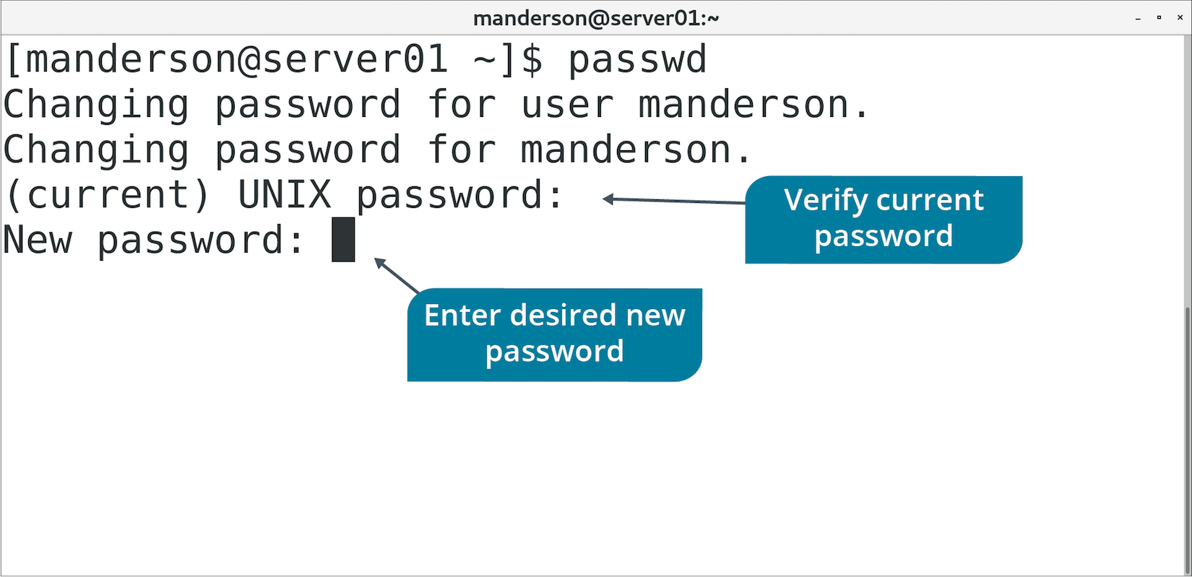
The passwd Command (Slide 2 of 2)

Slide 26
The /etc/passwd File
Stores account info.
All accounts found here.
Contains 7 fields separated by colons.
Field | Content
User name | Name user logs into system with.
Password | Password assigned to user (x means stored elsewhere).
User ID | Unique number representing user.
Group ID | Unique number of user's primary group.
Comment | User's full name (usually).
Home directory | Path to user's home directory.
Login shell | Path to shell launched when user logs in.
Notes:
Teaching Tip: Consider mentioning that a user ID in Linux is similar to the security identifier (SID) in Windows.

Slide 27
The /etc/shadow File (Slide 1 of 2)
/etc/passwd used to store hashed version of passwords.
Any user could see any other user's hash.
Passwords more easily cracked.
/etc/shadow is modern file location of hashed passwords.
Only root has access.
Includes addition info like password requirements and expiration info.

Slide 28
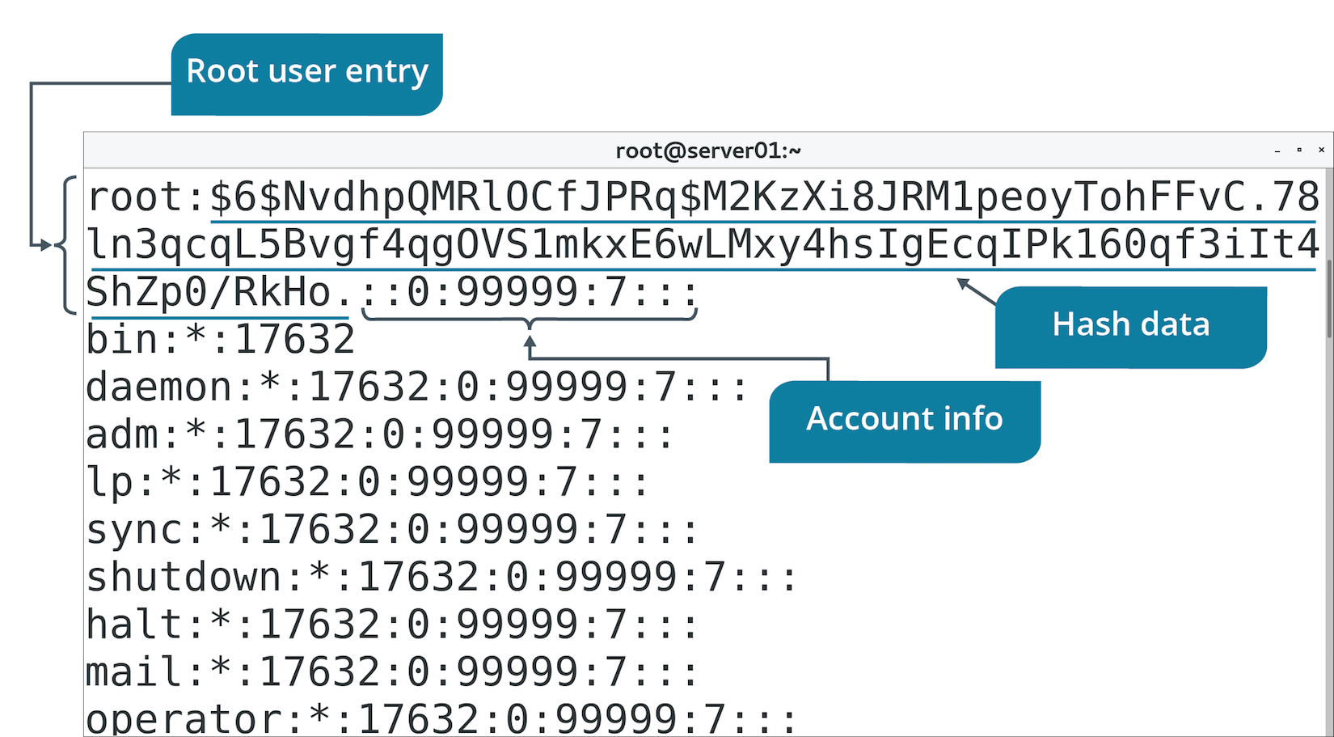
The /etc/shadow File (Slide 2 of 2)

Slide 29
Activity: Creating User Accounts
Managing user accounts is a responsibility for admins at Develetech.
You'll start by creating user accounts and viewing defaults.

Slide 30
The chage Command
"Change age"
Controls password expiration, warnings, inactive days, etc.
Option | Description | Example
-E | Sets account expiration at date/time. | chage -E 2022/12/31 user1
-l | Lists password aging info. | chage -l user1
-M | Sets max days password is valid for. | chage -M 90 user1
-m | Sets minimum days until password can be changed. | chage -m 1 user1
-W | Sets number of days before expiration user will be warned. | chage -W 5 user1

Slide 31
The usermod Command
Modifies settings for regular users.
Edits /etc/passwd file.
Option | Description | Example
-c | Sets comment field. | usermod -c "User One" user1
-e | Sets account expiration date. | usermod –e 2020/12/31 user1
-aG | Adds user to group, keeping them in existing groups. | usermod –aG sales-group user1
-l | Changes user's login name. | usermod –l user99 user1

Slide 32
Lock User Login
Locking account renders it unusable.
Still exists.
Can be unlocked when needed.
Lock:
passwd -l {user name}
usermod -L {user name}
Unlock:
passwd -u {user name}
usermod -U {user name}

Slide 33
Activity: Modifying User Accounts
You want to ensure accounts you created exist.
You'll set password requirements.
You'll investigate expiration/locking functionality.

Slide 34
The userdel Command
Deletes user accounts.
Doesn't delete home directory unless you use -r option.
Removes references to account.
Use caution before deleting accounts.

Slide 35
Discussing Creating, Modifying, and Deleting Users

Slide 36
Activity 2-5: Discussing Creating, Modifying, and Deleting Users
In which file are user accounts stored?
ANSWER:
/etc/passwd

Slide 37
Activity 2-5: Discussing Creating, Modifying, and Deleting Users
What are the three commands used to properly edit the /etc/passwd file?
ANSWER:
useradd, usermod, and userdel

Slide 38
Activity 2-5: Discussing Creating, Modifying, and Deleting Users
In which file are hashed passwords stored?
ANSWER:
/etc/shadow

Slide 39
Activity 2-5: Discussing Creating, Modifying, and Deleting Users
Why are /etc/passwd and /etc/shadow different files?
ANSWER:
The /etc/passwd file stores user account details such as user names, default shell, home directory, and group names. The /etc/shadow file contains the hashed passwords that are only readable by the root user account, whereas /etc/passwd is readable by everyone. Having a separate file for each, with different permissions, strengthens security.

Slide 40
Activity 2-5: Discussing Creating, Modifying, and Deleting Users
With which command can you change the default user shell to the KornShell for user bsmith?
ANSWER:
sudo usermod -s /bin/ksh bsmith

Slide 41
Activity: Deleting a User Account
Part of user account lifecycle is to delete accounts no longer needed.
You'll delete a test account.

Slide 42
Topic C: Create, Modify, and Delete Groups
Exam Objectives:
2.2 Given a scenario, manage users and groups.

Slide 43
Group Accounts
Access control objects that contains multiple users with similar security requirements.
Simplify admin tasks.
Multiple users can be granted permissions.
Represented by GID.
User can be member of multiple groups.

Slide 44
The /etc/group File (Slide 1 of 3)
Storage location for groups.
Commonly referenced for group info.
Don't manually edit file; use group commands.
Contains four fields separated by colons.

Slide 45
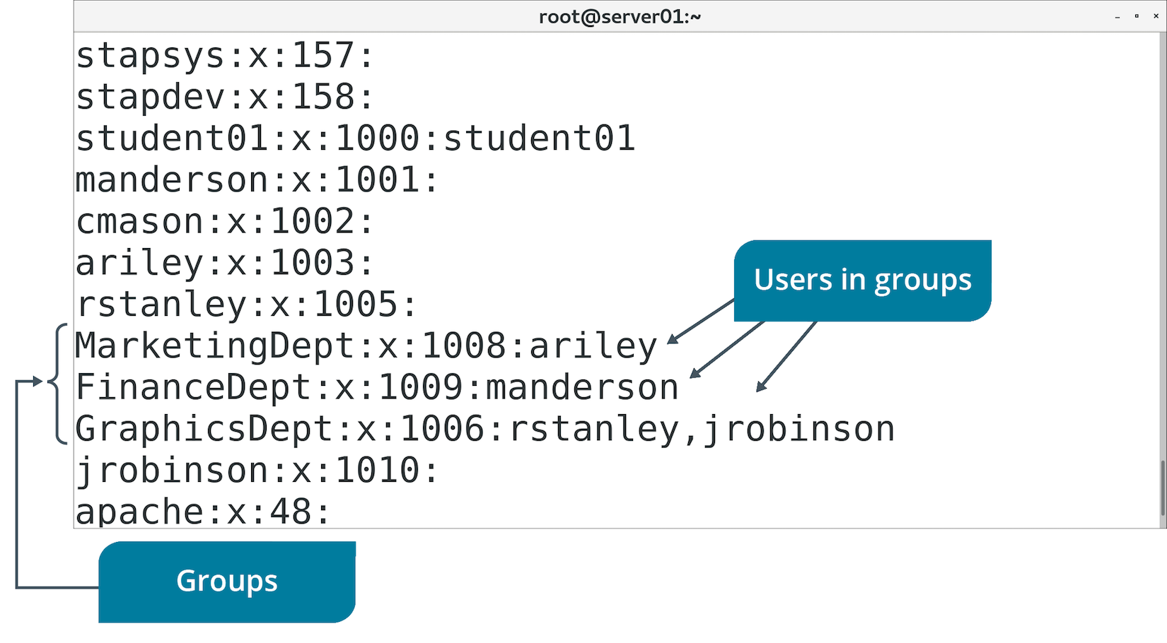
The /etc/group File (Slide 2 of 3)

Slide 46
The /etc/group File (Slide 3 of 3)
Field | Description
Group name | User-friendly name of group.
Password | Password required to enter group.
Group ID | GID by which system references group.
Group list | List of all group members.

Slide 47
The groupadd Command
Creates groups.
Group has no members/password by default.
Specify GID with -g option.
Option | Used To | Example
-g | Assign a group ID. | groupadd –g 123 sales
-f | Exit with success if group already exists. | groupadd –f sales
-o | Allow group creation with non-unique ID. | groupadd –o –g 123 sales

Slide 48
The groupmod Command
Changes group's attributes.
Edits /etc/group file.
Option | Used To | Example
-g | Change group ID. | groupmod –g 123 sales
-n | Rename group. | groupmod –n newsales sales

Slide 49
The groupdel Command
Deletes groups from /etc/group file.
Doesn't delete users.
Exercise caution when deleting groups.

Slide 50
Discussing Creating, Modifying, and Deleting Groups

Slide 51
Activity 2-7: Discussing Creating, Modifying, and Deleting Groups
Why do administrators, classes, and best practices state that you should manage users by managing groups?
ANSWER:
Managing groups simplifies user administration. Rather than granting explicit permissions to users on an individual basis, you grant them to groups and add users to those groups.

Slide 52
Activity 2-7: Discussing Creating, Modifying, and Deleting Groups
Which file contains the groups and user members of those groups?
ANSWER:
/etc/group

Slide 53
Activity 2-7: Discussing Creating, Modifying, and Deleting Groups
Which three commands does a system administrator use to properly edit a Linux system's group file?
ANSWER:
groupadd, groupmod, and groupdel

Slide 54
Activity 2-7: Discussing Creating, Modifying, and Deleting Groups
Which command does a system administrator use to add a user (bsmith) to an existing group (finance)?
ANSWER:
sudo usermod -aG finance bsmith

Slide 55
Activity 2-7: Discussing Creating, Modifying, and Deleting Groups
True or false? The groupmod command is used to change the name of an existing group.
ANSWER:
True.

Slide 56
Topic D: Query Users and Groups
Exam Objectives:
2.2 Given a scenario, manage users and groups.

Slide 57
Activity: Creating, Modifying, and Deleting Groups
You need to group users together to make management easier.
Groups will correspond to different departments.
You'll need to rename Graphics group to fit naming scheme.
You'll add users to groups.
You'll finish by deleting a group.

Slide 58
Account Querying
Admins may need to gather identity info.
Several commands can report user/group info.
Useful for troubleshooting problems.
Useful for verifying accounts logged in.

Slide 59
The whoami Command (Slide 1 of 2)
Displays user name you're currently logged in as.
You may need to switch users.
Not sure which one you're using at a given time.
Can also verify user name.

Slide 60
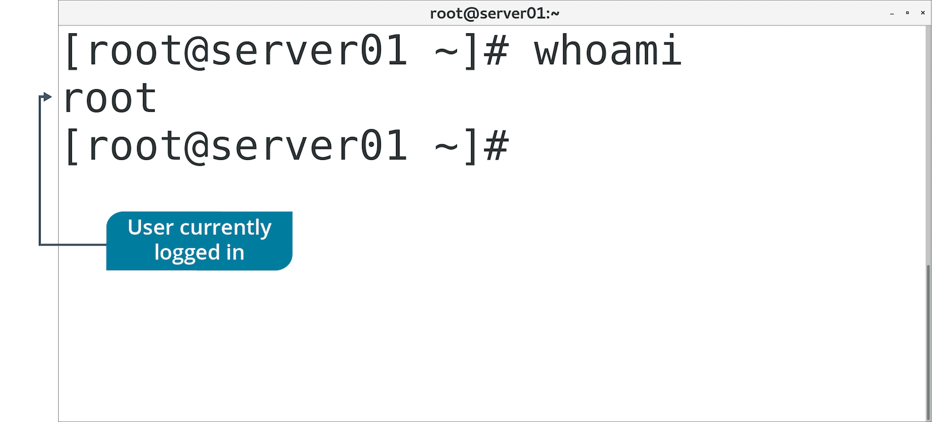
The whoami Command (Slide 2 of 2)

Slide 61
The who Command (Slide 1 of 2)
Determines details of users currently logged in.
Includes:
User name.
System user is connected to.
Date/time connected since.

Slide 62
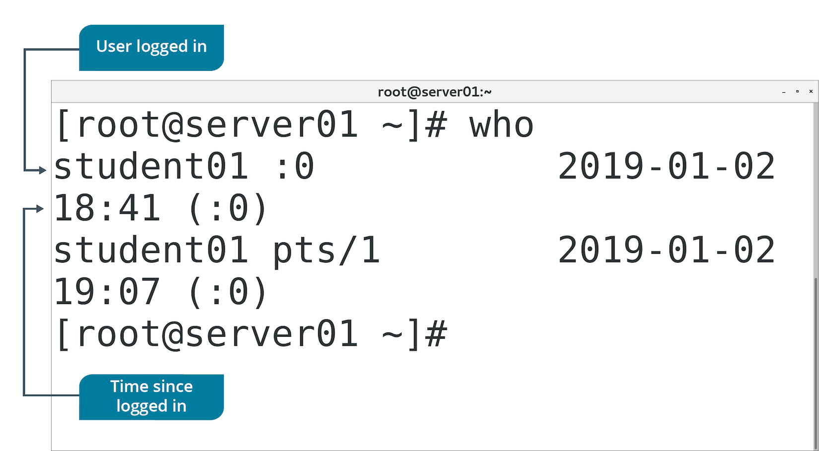
The who Command (Slide 2 of 2)

Slide 63
The w Command (Slide 1 of 2)
Displays details of logged in users and transactions.
First line displays status of system.
Second line displays table.
First column: users logged in.
Last column: current activities of users.
Other columns: various attributes of users.

Slide 64
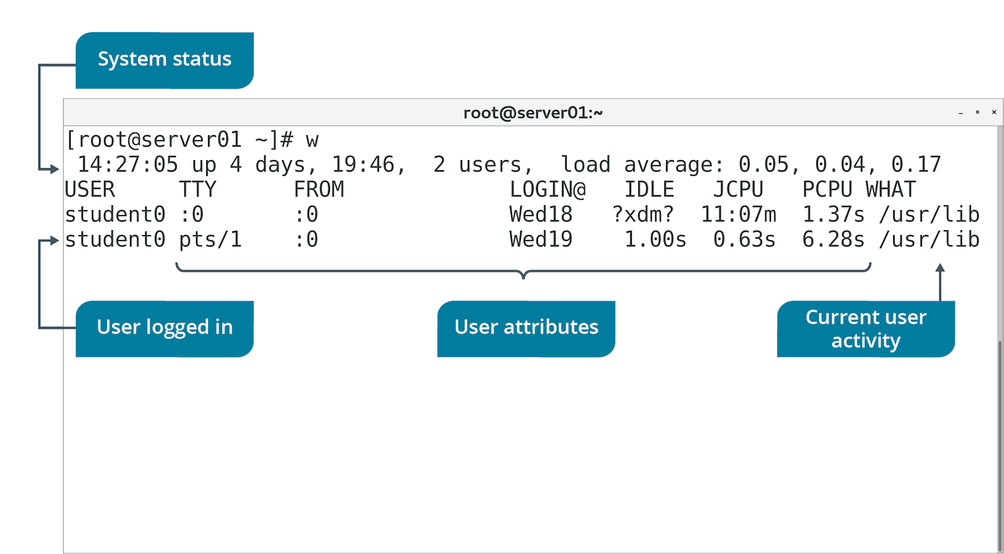
The w Command (Slide 2 of 2)

Slide 65
The last Command (Slide 1 of 2)
Displays history of user login/logout.
Options enable filtering of users by terminal.
last 1 filters results by users on first terminal.
Retrieves info from /var/log/wtmp file.

Slide 66
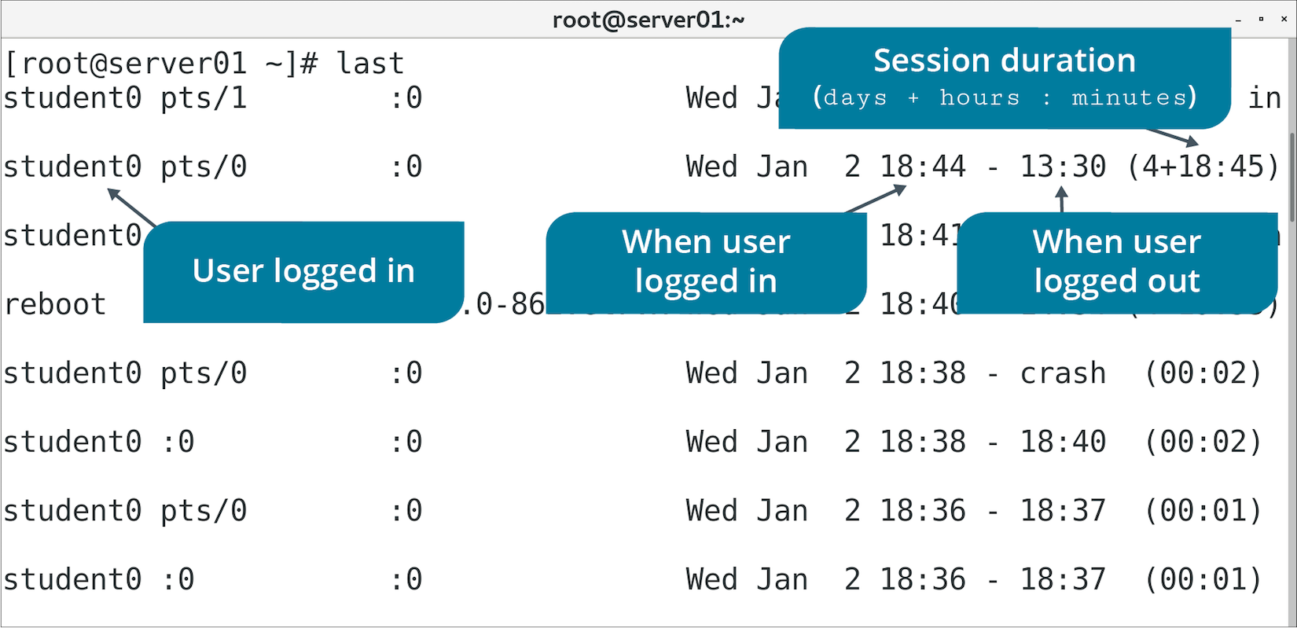
The last Command (Slide 2 of 2)

Slide 67
The id Command (Slide 1 of 2)
Displays UID/GID.
Without options, displays info about logged in user.
You can specify user name to display info about that user.

Slide 68
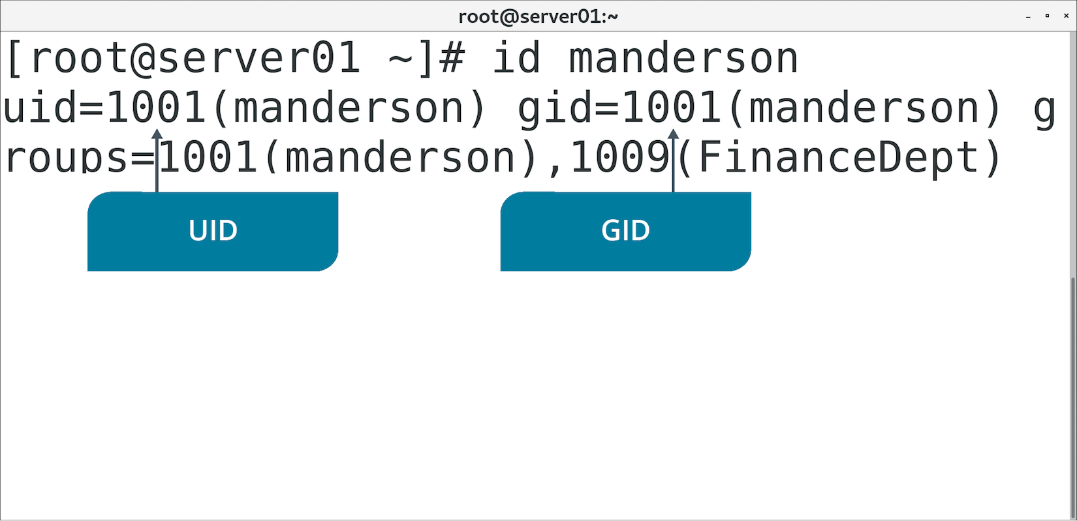
The id Command (Slide 2 of 2)

Slide 69
Discussing Querying Users and Groups

Slide 70
Activity 2-9: Discussing Querying Users and Groups
As a Linux administrator, you might often switch accounts from yours to the root user or to other user accounts to perform tasks. Which command can you issue to find out which user account you're currently using?
ANSWER:
whoami

Slide 71
Activity 2-9: Discussing Querying Users and Groups
You suspect that a hardware failure is imminent and you need to reboot the system to ensure that everything is working properly or to force a failure. Before issuing the reboot command, which command can you use to check to see if other users are logged onto the system?
ANSWER:
who

Slide 72
Activity 2-9: Discussing Querying Users and Groups
A user reports that she was working on an important script when the system rebooted at approximately 6:30 P.M. last night. No warning was given. How can you find out who was logged into the system at that time and who could have rebooted the system without warning?
ANSWER:
The last command will inform you as to who was logged into the system. If an administrator rebooted the system, you'll be able to identify him or her from the entries displayed. If the system crashed, last will also provide that information. Further investigation of systems logs may be required in the event of a crash.

Slide 73
Activity 2-9: Discussing Querying Users and Groups
As a system administrator, why might you issue the id command?
ANSWER:
The id command displays group information at a glance in an easy-to-read format.

Slide 74
Activity 2-9: Discussing Querying Users and Groups
As an administrator, you might need to reboot a system or otherwise perform maintenance. Which command would you issue to not only view logged on users but also their current activity?
ANSWER:
The w command displays idle time and the amount of CPU time consumed by user-owned processes. This information will tell you if it's safe to reboot a system or if you should ask users to log off first.

Slide 75
Activity: Querying Users and Groups
Several ways of gathering user/group info and logged in users.
You'll explore methods to answer any support questions.
Develetech policy requires log file of user logins.

Slide 76
Topic E: Configure Account Profiles
Exam Objectives:
2.2 Given a scenario, manage users and groups.

Slide 77
User Profiles
Individual users have habits and preferences for working with Linux.
Profile file configurations exist to customize experience.
Initial profile is created when account is created.
Many files/directories are used to create profile.

Slide 78
The .bashrc File (Slide 1 of 2)
Enables customization of user's environment.
Stored in home directory.
Unique to each user.
Example: Use of aliases.
Users can specify abbreviated commands for themselves.
Won't impact other users.
Example: Environment variables.
Example: Customize command prompt.
Notes:
Teaching Tip: Consider informing students that environment variables will be discussed in a later lesson.

Slide 79
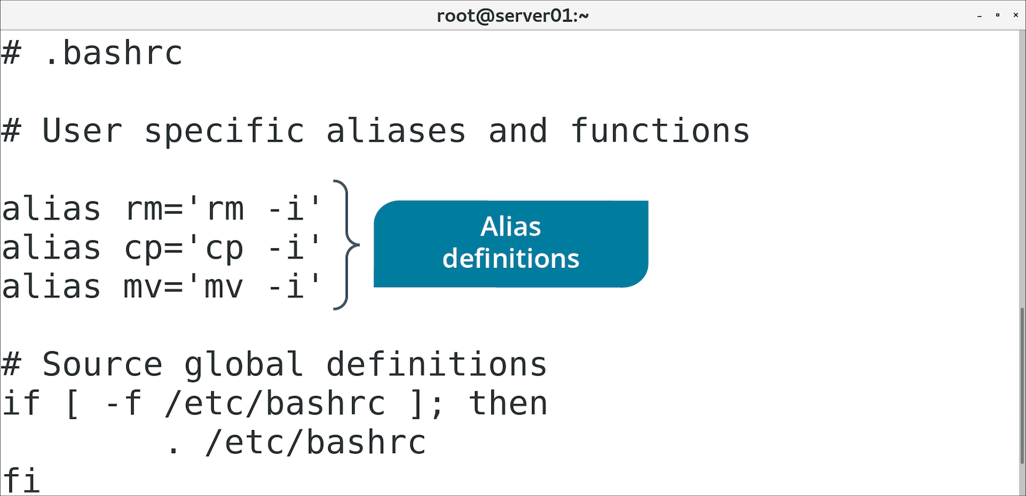
The .bashrc File (Slide 2 of 2)

Slide 80
The .bash_profile File (Slide 1 of 2)
Provides shell configuration for initial login.
Only read with first login.
.bashrc is read with all logins.
Default can be provided through /etc/skel/ directory.

Slide 81
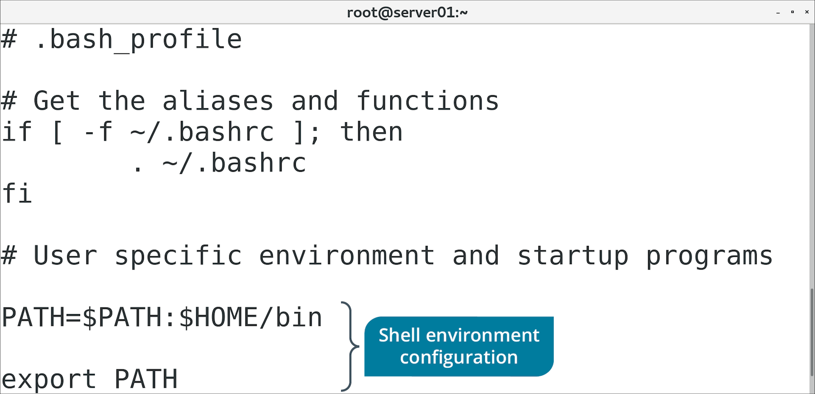
The .bash_profile File (Slide 2 of 2)

Slide 82
Global User Profiles
Admin may want to define system-wide settings.
Admin may want to configure initial settings for users.
Following files/directories enable flexible configurations.
Can be later customized by user.

Slide 83
The /etc/skel/ Directory
Contents are automatically copied to home directory of new users.
Admin can pre-populate directory.
useradd copies contents from directory.
Files added after account is created won't be copied.

Slide 84
The /etc/profile File
Provides system-wide environment variables.
Configure if settings need to apply to all users.
During login process:
/etc/profile checked first for shell configs.
User customizations then pulled from .profile in home directory.
Admins can define global shell settings, but still allow user-specific customization.
Notes:
Teaching Tip: Environment variables are discussed in more depth in a later lesson.

Slide 85
The /etc/profile.d/ Directory
Storage location for scripts used to set system-wide variables.
Recommended to set variables in scripts here.
Rather than edit /etc/profile directly.

Slide 86
The /etc/bashrc File
Provides system-wide Bash settings.
Different than /etc/profile (used for variables).

Slide 87
Discussing Account Profiles

Slide 88
Activity 2-11: Discussing Account Profiles
True or false? Using a dot at the beginning of a file name makes the file more secure.
ANSWER:
False. The file is hidden from normal view as a matter of organization, but does nothing for security.

Slide 89
Activity 2-11: Discussing Account Profiles
What is the primary difference between the .bashrc and the .bash_profile files?
ANSWER:
The .bash_profile file is executed upon first login to the system, and .bashrc is executed upon subsequent logins.

Slide 90
Activity 2-11: Discussing Account Profiles
Which directory's contents are copied to the user's home directory upon account creation?
ANSWER:
/etc/skel

Slide 91
Activity 2-11: Discussing Account Profiles
Which file forces system-wide customizations for all users on a system that a user cannot change?
ANSWER:
/etc/profile

Slide 92
Activity 2-11: Discussing Account Profiles
Where should administrators set system-wide variables on a Linux system rather than editing the /etc/profile file directly?
ANSWER:
In scripts within the /etc/profile.d directory.

Slide 93
Activity: Configuring Account Profiles
You're concerned that changes may be difficult for users.
You need to customize user environments for consistency.
You need to place a copy of policies in each new user's home directory.

Slide 94
How might you design groups in your organization?
How might you manage root privileges in your organization?

